Slide 1




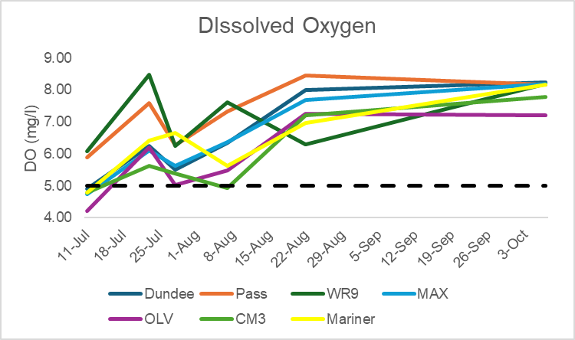
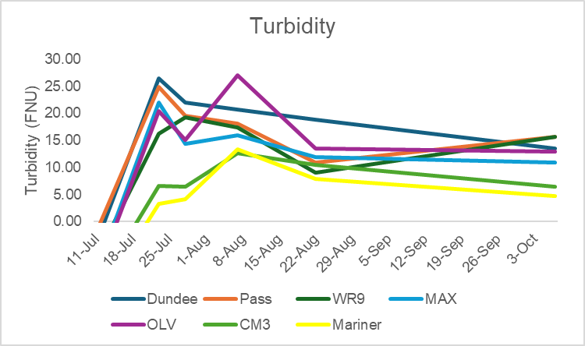
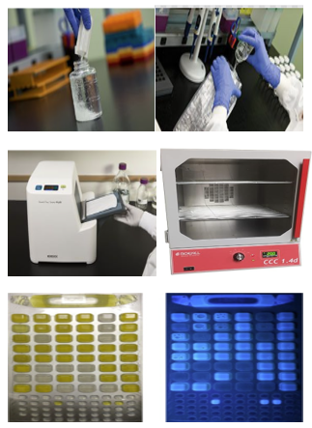
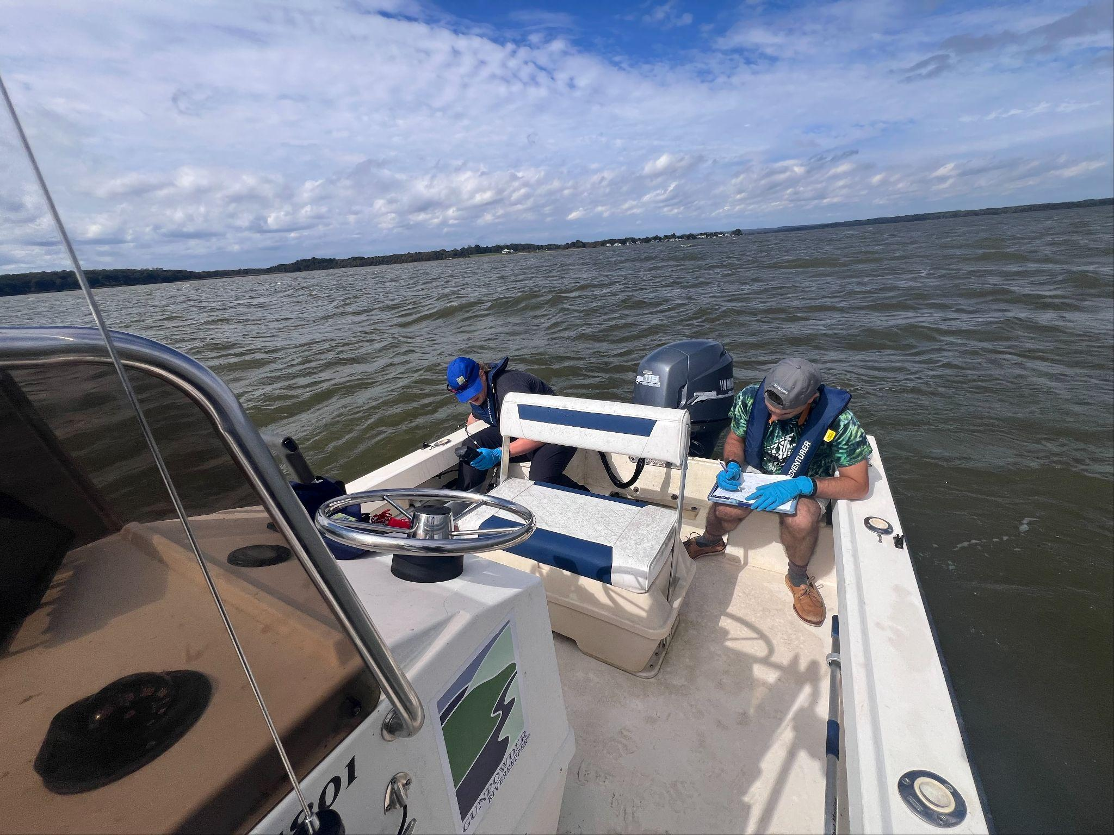
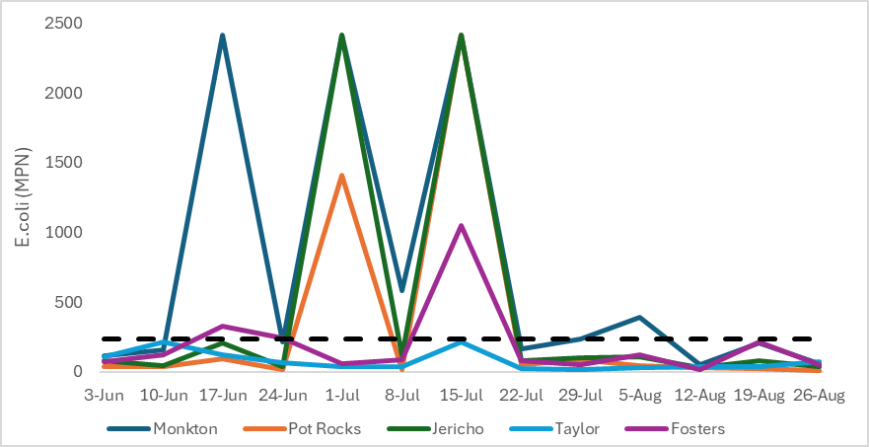
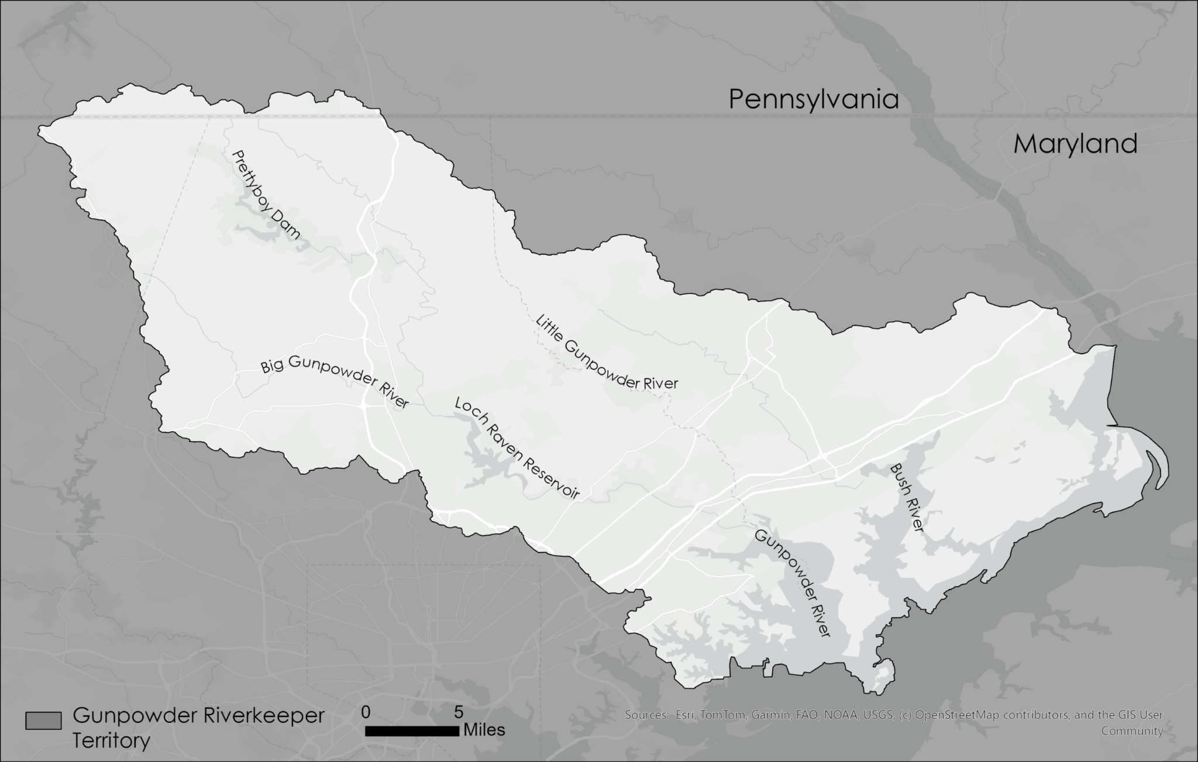
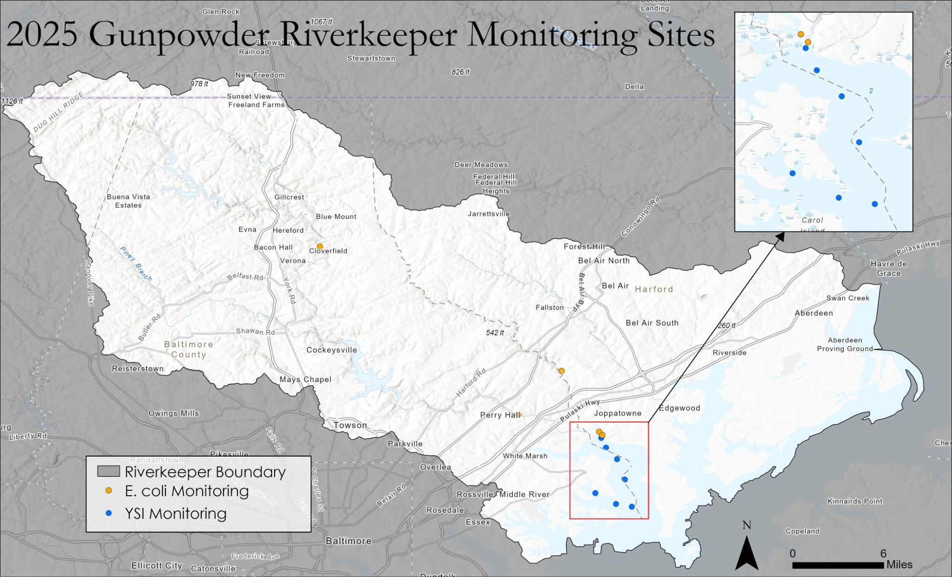
Bacterial and Water Quality Monitoring in the Gunpowder River
*Chichedo I. Duru¹⁻², Braeden Bayne², Tristan McGregor²⁻³, Sophie Zuckman^{2,4}, Steve Duker², Theaux Le Gardeur²
¹Morgan State University, Baltimore, MD, 21251;
²Gunpowder Riverkeeper, Monkton, MD, 21111;
³ Towson University, Towson, MD 21252;
⁴ Skidmore College, Saratoga Springs, NY 12866
Abstract
Methodology
Results For YSI Monitoring
Gunpowder Riverkeeper® is a 501(c)(3) nonprofit that protects water quality, sensitive species, and community interests in the traditionally overburdened Bird, Bush, Middle, and Gunpowder River watersheds. Comprising roughly 800mi² these watersheds host Brook Trout in the upper, forested reaches and Atlantic Sturgeon in the tidal basins. Over 1.5 million people in the Baltimore-Metro area use the Gunpowder for drinking water and many more for recreation: fishing, crabbing, boating, and swimming. 26 species of finfish use areas such as this for spawning. Gunpowder RIVERKEEPER® monitors water quality throughout the watersheds. Bacterial monitoring for Escherichia coli (E.coli) takes place at five sites using the IDEXX method. Physio-chemical parameters are measured in the tidal Gunpowder using a YSI at seven sites on dates corresponding to satellite overpasses of the Landsat-9 and Sentinel-2A to assist in “ground-truthing” for the Smithsonian Environmental Research Center (SERC) Chesapeake Water Watch Program. Six sites are monitored for quality and contamination downstream of an industrial site outfall where dissolved Oxygen and Phosphorus levels do not meet the current state standards.
E.coli Monitoring
IDEXX Method
Weekly sampling during Summer Swimming Season (Memorial Day-Labor Day) in five locations
Grab samples taken before noon
YSI Monitoring
Samples taken to correspond to satellite overpasses
Measurements taken in triplicates at seven sites
Chesapeake Water Watch
CDOM, Chlorophyll A, and Turbidity measured using SERC benchtop machines with data uploaded to field scope
E. Coli Analysis
YSI Data Collection
Figure 4: Results for Dissolved Oxygen (mg/L)
Figure 5: Results for Turbidity (FNU)
Introduction
Discussion
The Bird, Bush, Middle, and Gunpowder River watersheds covers roughly 800 mi² and lead into the Chesapeake Bay
Drinking and recreational water to nearly 1.5 million residents in Baltimore Metro Area
Nursery ground for 26 species of Chesapeake Bay finfish[1].
Recreation, fishing, and drinking water are all primary uses of the Bird, Bush, Middle, and Gunpowder River watersheds.
Large industrial presence (116 sites) in the tidal basin has prompted monitoring of water quality and the organization is seeking funding to undertake this work.
Results For E.coli Monitoring
Objective
*
*
*
* Samples collected in wet conditions.
Conclusion
To assess bacterial levels and water quality conditions within the Gunpowder Watershed.
Ecosystem Impact: Bacteria levels in non-traditional swimming areas affects water quality and recreational safety
Rainfall events influence bacteria levels
Correlation may exist between DO and turbidity and needs further study.
HIGHLIGHT
During the peak of the swimming season social media impressions reached nearly 250,000 unique visitors.
Gunpowder RIVERKEEPER® Territory
EPA 235 MPN Threshold [2]
Figure 2: Levels of E. coli in MPN
Acknowledgement
Thanks to Towson University, Skidmore College, Morgan State University for allowing their students to provide capacity to Gunpowder RIVERKEEPER® efforts in monitoring water quality in tidal and non tidal areas and providing outreach to the community.
References
https://gunpowderriverkeeper.org/watershed-overview/
https://mde.maryland.gov/programs/water/Beaches/Documents/factsheetepawgbeaches_jan2013rev0613.pdf
https://mde.maryland.gov/programs/water/MHB/Pages/Maryland-Healthy-Beaches-Home.aspx
Figure 1: Map of the territory that Gunpowder RIVERKEEPER® covers
Figure 3: Map of E.coli and YSI Monitoring Sites

